Slide 1
EQUIPMENT’S CLASSROOM MANAGEMENT
Group 10:
Trần Vĩnh Quang – SE61078
Tăng Việt Hưng – SE61019
Đoàn Nguyễn Minh Chí – SE60717
Supervisor:
Kiều Trọng Khánh

Slide 2
OUTLINE
Current Situation
Solution
Demonstration
Advantages and Disadvantages
Question and Answers

Slide 3


CURRENT SITUATION
Staff

Slide 4
CURRENT SITUATION
Number of equipment
Status of equipment
Damage of equipment
Staff
Time remain of equipment

Slide 5
CURRENT SITUATION
1
Managing equipment is manual

Slide 6


CURRENT SITUATION
Teacher
6

Slide 7
CURRENT SITUATION
Staff
Teacher
7

Slide 8
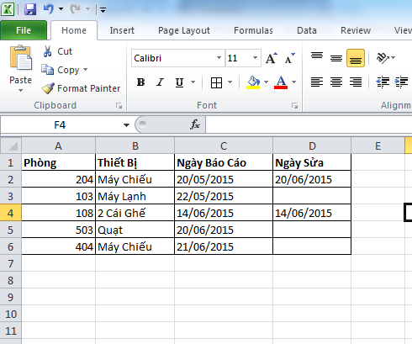
CURRENT SITUATION
Check history of equipment

Slide 9
CURRENT SITUATION
“Change Room”
Teacher

Slide 10
CURRENT SITUATION
“Change Room”
Analyze damage
Staff
Teacher

Slide 11
CURRENT SITUATION
“Change Room”
Analyze damage
Staff
Teacher
Change room for teacher

Slide 12
CURRENT SITUATION
What room ?
Teacher

Slide 13
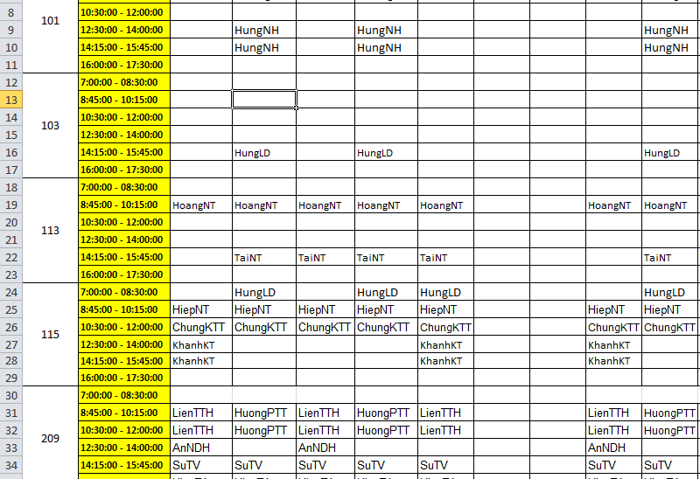
CURRENT SITUATION

Slide 14
CURRENT SITUATION

Slide 15
CURRENT SITUATION
What room ?
103
Teacher

Slide 16
CURRENT SITUATION
What room ?
103
Teacher
Change to 301

Slide 17
CURRENT SITUATION
1
Managing equipment is manual
2
Waste time when receive and resolve report

Slide 18
CURRENT SITUATION
How to notice other teacher ?

Slide 19
CURRENT SITUATION
Notice in classroom

Slide 20
CURRENT SITUATION
Notice to teacher

Slide 21
CURRENT SITUATION
1
Managing equipment is manual
2
Waste time when receive and resolve report
3
Hard to notice when needed

Slide 22
CURRENT SITUATION
1
Managing equipment is manual
2
Waste time when receive and resolve report
3
Hard to notice when needed
4
Require human resource

Slide 23
SOLUTION
ECRM
Teacher

Slide 24
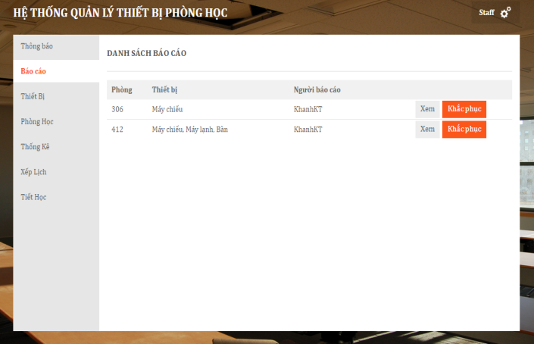
SOLUTION
ECRM

Slide 25
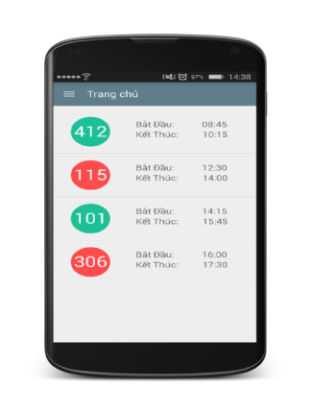
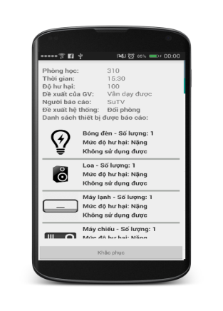
SOLUTION
ECRM

Slide 26
SOLUTION
Managing equipment is automatic
ECRM

Slide 27
SOLUTION
Managing equipment is automatic
Automatically receive and analyze data report
ECRM

Slide 28
SOLUTION
Managing equipment is automatic
Automatically receive and analyze data report
ECRM
Notice based on SMS and notification in real time

Slide 29
SOLUTION
Managing equipment is automatic
Automatic receive and resolve report
Automatically receive and analyze data report
ECRM
Notice based on SMS and notification in real time
Notice base on SMS, real time
Require less human resource

Slide 30
CLASSROOM
CLASSROOM OBJECT
ClassName
NumberSlot

Slide 31
CLASSROOM
CLASSROOM OBJECT
ClassName
NumberSlot
EQUIPMENT CATEGORY OBJECT
ClassName
Name
0.. *

Slide 32
CLASSROOM
CLASSROOM OBJECT
ClassName
NumberSlot
EQUIPMENT CATEGORY OBJECT
ClassName
Name
0.. *
0.. *

Slide 33
CLASSROOM
ROOMTYPE OBJECT
EQUIPMENT CATEGORY OBJECT
Name
CLASSROOM OBJECT
ClassName
NumberSlot

Slide 34
CLASSROOM
ROOMTYPE OBJECT
RoomTypeID
0..1
EQUIPMENT CATEGORY OBJECT
Name
CLASSROOM OBJECT
ClassName
NumberSlot
RoomTypeID
0..*

Slide 35
CLASSROOM
ROOMTYPE OBJECT
RoomTypeID
0..1
0..*
EQUIPMENT CATEGORY OBJECT
Name
CLASSROOM OBJECT
ClassName
NumberSlot
RoomTypeID
0..*
0..*

Slide 36
CLASSROOM
ROOMTYPE OBJECT
RoomTypeID
0..1
0..*
EQUIPMENT CATEGORY OBJECT
Name
CLASSROOM OBJECT
ClassName
NumberSlot
RoomTypeID
0..*
0..*

Slide 37
CLASSROOM
EQUIPMENT QUANTITY OBJECT
RoomTypeID
EquipmentName
Quantity
Priority
0..*
0..*
ROOMTYPE OBJECT
RoomTypeID
EQUIPMENT CATEGORY OBJECT
Name
1..1
1..1

Slide 38
CLASSROOM
CLASSROOM OBJECT
ClassName
NumberSlot
RoomTypeID

Slide 39
CLASSROOM
CLASSROOM OBJECT
ClassName
NumberSlot
RoomTypeID
ROOMTYPE OBJECT
RoomTypeID
0..*
0..1

Slide 40
CLASSROOM
CLASSROOM OBJECT
ClassName
NumberSlot
RoomTypeID
ROOMTYPE OBJECT
RoomTypeID
0..*
0..1
1..1
0..*
EQUIPMENT QUANTITY OBJECT
RoomTypeID
EquipmentName
Quantity
Priority

Slide 41
CLASSROOM
CLASSROOM OBJECT
ClassName
NumberSlot
RoomTypeID
ROOMTYPE OBJECT
RoomTypeID
0..*
0..1
1..1
0..*
EQUIPMENT CATEGORY OBJECT
Name
EQUIPMENT QUANTITY OBJECT
RoomTypeID
EquipmentName
Quantity
Priority
1..1
0..*

Slide 42
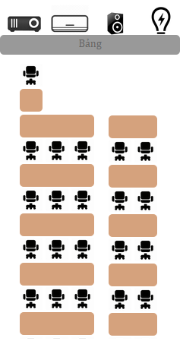

ROOM TYPE

Slide 43
ROOM TYPE
ROOMTYPE OBJECT
RoomTypeID
Name
VerticalRows

Slide 44
ROOM TYPE
ROOMTYPE OBJECT
RoomTypeID
Name
VerticalRows
HorizontalRows

Slide 45
ROOM TYPE
ROOMTYPE OBJECT
RoomTypeID
Name
VerticalRows
HorizontalRows
NumberOfSlotsEachHRows

Slide 46
ROOM TYPE
ROOMTYPE OBJECT
RoomTypeID
Name
VerticalRows
HorizontalRows
NumberOfSlotsEachHRows
EQUIPMENT QUANTITY OBJECT
RoomTypeID
EquipmentName

Slide 47
DEMONSTRATION

Slide 48
SCHEDULE
Update equipment using time
Why need schedule ?

Slide 49
SCHEDULE
Update equipment using time
Why need schedule ?
Find available room when needed

Slide 50
SCHEDULE
Update equipment using time
Why need schedule ?
Find available room when needed
Check report of user

Slide 51
SCHEDULE
SCHEDULE OBJECT
Username
ClassName
ScheduleConfigID
Date
SCHEDULE CONFIG OBJECT
Slot
TimeFrom
TimeTo
0..*
1..1

Slide 52
SCHEDULE
How to import schedule ?
Manual
Import File

Slide 53
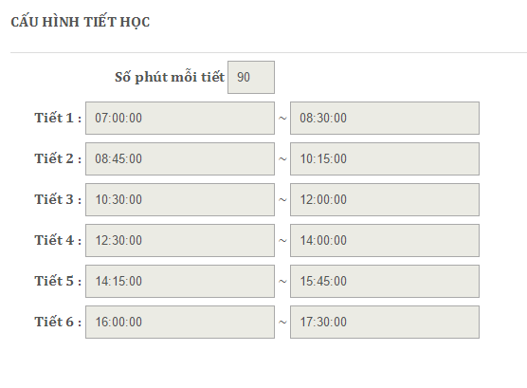
SCHEDULE
Config Schedule
1

Slide 54
SCHEDULE
Config Schedule
1
2
SCHEDULE CONFIG OBJECT
Slot
TimeFrom
TimeTo

Slide 55
SCHEDULE
Config Schedule
1
2
SCHEDULE CONFIG OBJECT
Slot
TimeFrom
TimeTo

Slide 56
SCHEDULE
Config Schedule
1
2
SCHEDULE CONFIG OBJECT
Slot
TimeFrom
TimeTo

Slide 57
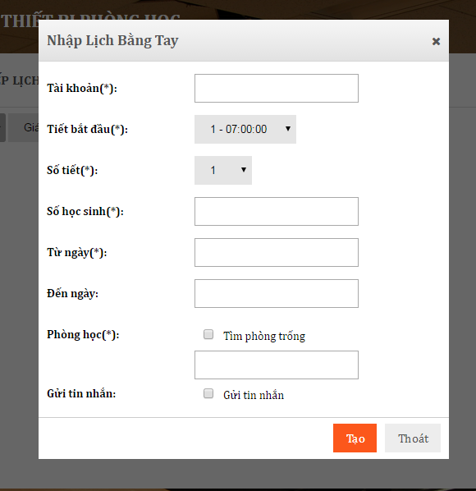
SCHEDULE
Manual
1

Slide 58
SCHEDULE
Manual
1
2
SCHEDULE OBJECT
Username
ClassName
ScheduleConfigID
NoStudents
Date
SCHEDULE CONFIG OBJECT
Slot
TimeFrom
TimeTo

Slide 59
SCHEDULE
Manual
1
2
SCHEDULE OBJECT
Username
ClassName
ScheduleConfigID
NoStudents
Date
SCHEDULE CONFIG OBJECT
Slot
TimeFrom
TimeTo

Slide 60
SCHEDULE
Manual
1
2
SCHEDULE OBJECT
Username
ClassName
ScheduleConfigID
NoStudents
Date
SCHEDULE CONFIG OBJECT
Slot
TimeFrom
TimeTo

Slide 61
SCHEDULE
Manual
1
2
SCHEDULE OBJECT
Username
ClassName
ScheduleConfigID
NoStudents
Date
SCHEDULE CONFIG OBJECT
Slot
TimeFrom
TimeTo

Slide 62
SCHEDULE
Manual
1
2
SCHEDULE OBJECT
Username
ClassName
ScheduleConfigID
NoStudents
Date
SCHEDULE CONFIG OBJECT
Slot
TimeFrom
TimeTo

Slide 63
SCHEDULE
Import File

Slide 64
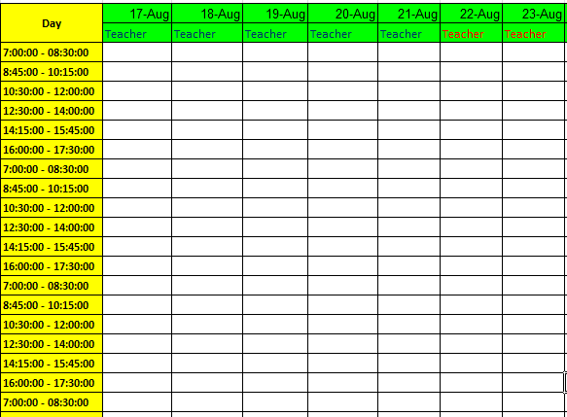
SCHEDULE
Import File
1
Download template from server

Slide 65
SCHEDULE
Import File
1
2
Download template from server
Fill to template

Slide 66
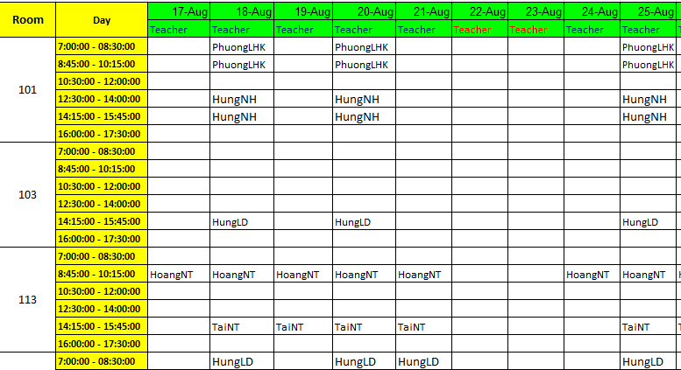
SCHEDULE

Slide 67
SCHEDULE
Import File
1
2
3
Download template from server
Fill to template
Import to server

Slide 68
DEMONSTRATION

Slide 69
UPDATE EQUIPMENT TIME USING
Time:
06:00 AM Every day

Slide 70
UPDATE EQUIPMENT TIME USING
Time:
06:00 AM Every day
Actor:
System

Slide 71
UPDATE EQUIPMENT TIME USING
Time:
06:00 AM Every day
Actor:
System
Goal:
Update time using of equipment
Notice about maintenance for staff
Change status for equipment when equipment is expired

Slide 72
UPDATE EQUIPMENT TIME USING
Step 1:
Get schedule of classroom yesterday
System calculate total time of schedule in yesterday. Update time remain of equipment
YES
Is there any schedule ?
NO
Finish current classroom, and update for another classroom

Slide 73
UPDATE EQUIPMENT TIME USING
Step 2:
Check time remain of equipment
Change status classroom to “Damaged”. Notify for teacher and staff. Finish.
YES
Is time remain < 0
NO
Notify to staff. Finish

Slide 74
DEMONSTRATION

Slide 75
REPORT DAMAGED EQUIPMENT
Time:
After teach in class
Actor:
Teacher
Goal:
Report about damage equipment

Slide 76

REPORT DAMAGED EQUIPMENT

Slide 77
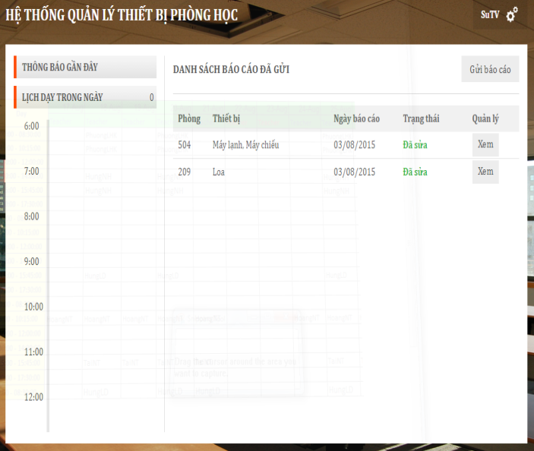
REPORT DAMAGED EQUIPMENT

Slide 78

REPORT DAMAGED EQUIPMENT

Slide 79
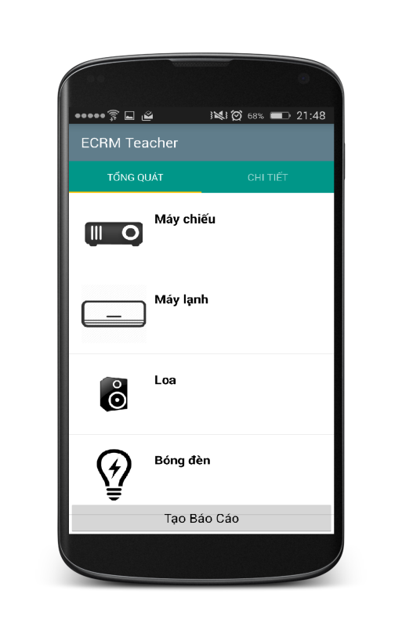
REPORT DAMAGED EQUIPMENT
Step 1:
Choose damaged equipment and evaluate

Slide 80

REPORT DAMAGED EQUIPMENT
Step 2:
Send report to server

Slide 81
REPORT DAMAGED EQUIPMENT
REPORT OBJECT
Username
ClassName
Evaluate
Date
1..1
0..*
REPORT DETAIL OBJECT
EquipmentName
DamageLevel
Evaluate

Slide 82

REPORT DAMAGED EQUIPMENT
Step 3:
Save data to database

Slide 83
REPORT DAMAGED EQUIPMENT
Step 4:
Notify to staff

Slide 84

REPORT DAMAGED EQUIPMENT
Step 5:
Analyze data from report

Slide 85
REPORT DAMAGED EQUIPMENT
Step 6:
Send notification to teacher

Slide 86

REPORT DAMAGED EQUIPMENT
Step 7:
Send notification to another teacher

Slide 87
ANALYZE DATA AND MAKING DECISION

Slide 88
ANALYZE DATA AND MAKING DECISION
REPORT OBJECT
Username
ClassName
Evaluate
Date
1..1
0..*
REPORT DETAIL OBJECT
EquipmentName
DamageLevel
Evaluate

Slide 89
ANALYZE DATA AND MAKING DECISION
REPORT OBJECT
Username
ClassName
Evaluate
Date
ROOM TYPE OBJECT
NoSlots
List Equipments
List Equipment’s Priority
1..1
0..*
REPORT DETAIL OBJECT
EquipmentName
DamageLevel
Evaluate

Slide 90

ANALYZE DATA AND MAKING DECISION

Slide 91
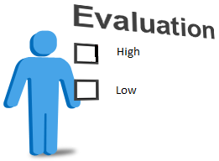
ANALYZE DATA AND MAKING DECISION

Slide 92

ANALYZE DATA AND MAKING DECISION
High
Medium
Low

Slide 93
ANALYZE DATA AND MAKING DECISION
High
Medium
Low
Damaged level

Slide 94

ANALYZE DATA AND MAKING DECISION
REPORT

Slide 95
ANALYZE DATA AND MAKING DECISION
REPORT
ROOM TYPE

Slide 96
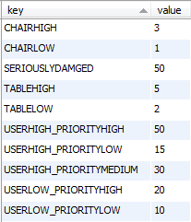
ANALYZE DATA AND MAKING DECISION
REPORT
Step 1:
Analyze data
Evaluate is “Không thể sử dụng”
CONFIGURATION
ROOM TYPE
Priority is “Cao”

Slide 97
ANALYZE DATA AND MAKING DECISION
REPORT
Step 1:
Analyze data
50
CONFIGURATION
ROOM TYPE

Slide 98
ANALYZE DATA AND MAKING DECISION
REPORT
Step 1:
Analyze data
50
CONFIGURATION
Evaluate is “Có thể sử dụng”
ROOM TYPE
Priority is “Thấp”

Slide 99
ANALYZE DATA AND MAKING DECISION
REPORT
Step 1:
Analyze data
50
CONFIGURATION
10
ROOM TYPE

Slide 100
ANALYZE DATA AND MAKING DECISION
REPORT
50
CONFIGURATION
10
ROOM TYPE
60

Slide 101
ANALYZE DATA AND MAKING DECISION
Step 2:
Making decision

Slide 102
ANALYZE DATA AND MAKING DECISION
Step 2:
Making decision
CONFIGURATION
Get seriously damage in database

Slide 103
ANALYZE DATA AND MAKING DECISION
Step 2:
Making decision
Get seriously damage in database
Is damage level larger than seriously damage ?

Slide 104
ANALYZE DATA AND MAKING DECISION
Step 2:
Making decision
Get seriously damage in database
Is damage level larger than seriously damage ?
NO
YES
Find available room and change room
Update damage for classroom. Finish.

Slide 105
FIND AVAILABLE ROOM
Time:
Actor:
System
Goal:
Find available room to change

Slide 106
FIND AVAILABLE ROOM
Class Name: 302
Room Type: “Thông Dụng” with 30 slots, 2 air conditioner,

Slide 107
FIND AVAILABLE ROOM
Step 1:
Get undamaged classrooms
202
303
201
301
402
101
503
List undamaged classrooms

Slide 108
FIND AVAILABLE ROOM
Step 2:
Sort by floor
Class Name: 302
202
303
201
301
402
101
503
List undamaged classrooms

Slide 109
FIND AVAILABLE ROOM
Step 2:
Sort by floor
Class Name: 302
Sort
202
303
201
301
402
101
503
301
List undamaged classrooms

Slide 110
FIND AVAILABLE ROOM
Step 2:
Sort by floor
Class Name: 302
Sort
202
303
201
301
402
101
503
301
303
List undamaged classrooms

Slide 111
FIND AVAILABLE ROOM
Step 2:
Sort by floor
Class Name: 302
Sort
202
303
201
301
402
101
503
301
303
201
List undamaged classrooms

Slide 112
FIND AVAILABLE ROOM
Step 2:
Sort by floor
Class Name: 302
Sort
202
303
201
301
402
101
503
301
303
201
202
List undamaged classrooms

Slide 113
FIND AVAILABLE ROOM
Step 2:
Sort by floor
Class Name: 302
Sort
202
303
201
301
402
101
503
301
303
201
202
402
List undamaged classrooms

Slide 114
FIND AVAILABLE ROOM
Step 2:
Sort by floor
Class Name: 302
Sort
202
303
201
301
402
101
503
301
303
201
202
402
101
List undamaged classrooms

Slide 115
FIND AVAILABLE ROOM
Step 2:
Sort by floor
Class Name: 302
Sort
202
303
201
301
402
101
503
301
303
201
202
402
101
503
List undamaged classrooms
List sort by floor

Slide 116
FIND AVAILABLE ROOM
Step 3:
Compare with room type
Room Type: “Thông Dụng” with 30 slots, 2 air conditioner,…
301
303
201
202
402
101
503
List sort by floor

Slide 117
FIND AVAILABLE ROOM
Step 3:
Compare with room type
Room Type: “Thông Dụng” with 30 slots, 2 air conditioner,…
Compare
301
303
201
202
402
101
503
301
303
201
202
402
101
503
List sort by floor
Room Type is “Thông Dụng”

Slide 118
FIND AVAILABLE ROOM
Step 3:
Compare with room type
Room Type: “Thông Dụng” with 30 slots, 2 air conditioner,…
Compare
301
303
201
202
402
101
503
503
301
303
201
202
402
101
List sort by floor
Room Type is “Thông Dụng”

Slide 119
FIND AVAILABLE ROOM
Step 3:
Compare with room type
Room Type: “Thông Dụng” with 30 slots, 2 air conditioner,…
Compare
301
303
201
202
402
101
503
503
301
303
201
202
402
101
List sort by floor
Room Type is smaller than current Room Type

Slide 120
FIND AVAILABLE ROOM
Step 3:
Compare with room type
Room Type: “Thông Dụng” with 30 slots, 2 air conditioner,…
Compare
301
303
201
202
402
101
503
402
503
301
303
201
202
101
List sort by floor
Room Type is equal current Room Type

Slide 121
FIND AVAILABLE ROOM
Step 3:
Compare with room type
Room Type: “Thông Dụng” with 30 slots, 2 air conditioner,…
Compare
301
303
201
202
402
101
503
202
402
503
301
303
201
101
List sort by floor
Room Type is larger current Room Type

Slide 122
FIND AVAILABLE ROOM
Step 3:
Compare with room type
Room Type: “Thông Dụng” with 30 slots, 2 air conditioner,…
Compare
301
303
201
202
402
101
503
202
402
503
301
303
201
101
List sort by floor
Room Type is smaller than current Room Type

Slide 123
FIND AVAILABLE ROOM
Step 3:
Compare with room type
Room Type: “Thông Dụng” with 30 slots, 2 air conditioner,…
Compare
301
303
201
202
402
101
503
202
402
503
301
303
201
101
List sort by floor
Room Type is smaller than current Room Type

Slide 124
FIND AVAILABLE ROOM
Step 3:
Compare with room type
Room Type: “Thông Dụng” with 30 slots, 2 air conditioner,…
Compare
301
303
201
202
402
101
503
202
402
503
301
303
201
101
List sort by floor
Room Type is smaller than current Room Type

Slide 125
FIND AVAILABLE ROOM
Step 3:
Compare with room type
Room Type: “Thông Dụng” with 30 slots, 2 air conditioner,…
Compare
301
303
201
202
402
101
503
202
402
503
301
303
201
101
List sort by floor
List after compare

Slide 126
FIND AVAILABLE ROOM
Class Name: 302
Room Type: “Thông Dụng” with 30 slots, 2 air conditioner,
202
402
503
301
303
201
101
202
Result
List after compare

Slide 127
DEMONSTRATION

Slide 128
CHECK STATUS OF CLASSROOM
Time:
06:30 AM - 12:15 PM Every day
Actor:
System
Goal:
Checking current status of classroom
Make decision when needed

Slide 129
CHECK STATUS OF CLASSROOM
Step 1
Get all classrooms has damaged level larger than seriously damaged

Slide 130
CHECK STATUS OF CLASSROOM
Step 1
Get all classrooms has damaged level larger than seriously damaged
Step 2
Find available room to change

Slide 131
CHECK STATUS OF CLASSROOM
Step 1
Get all classrooms has damaged level larger than seriously damaged
Step 2
Find available room to change
Step 3
Change room and notice to teacher

Slide 132
DEMONSTRATION

Slide 133
RESOLVE REPORT
Time:
06:00 AM Every day
Actor:
Staff
Goal:
Update time using of equipment
Update time using of equipment
Change status for classroom when equipment has expired

Slide 134
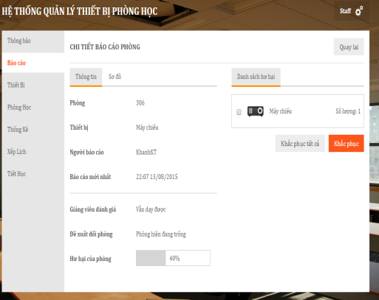

RESOLVE REPORT

Slide 135

RESOLVE REPORT

Slide 136
DEMONSTRATION

Slide 137
ADVANTAGE & DISADVANTAGE
Advantage
Require less human source
Save time when receive and resolve report
Easy to check status of equipment, classroom
User interface is friendly, easy to use.
Disadvantage
Can not check user behavior.
Only support for Android OS.

Slide 138
Q&A

